Slide 1

EnOcean technology for intelligent and green buildings.
Author

Slide 2
Overview
Why wireless & batteryless?
EnOcean – the batteryless wireless technology
Installation
Radio: Basics & range planning
Support & next steps
Page 2

Slide 3
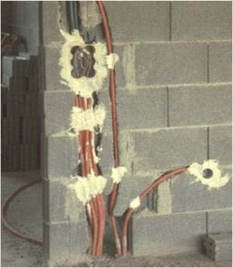
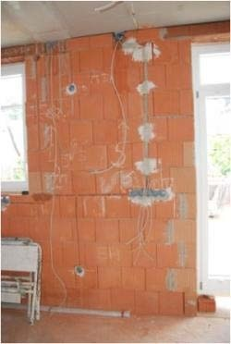
Current state with many installations
Page 3

Slide 4
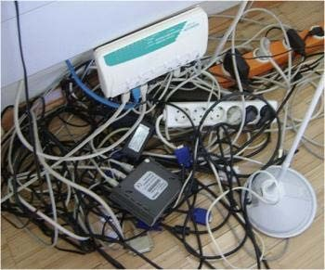
Current state
Page 4

Slide 5
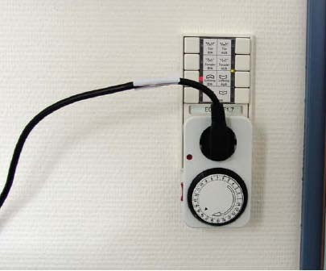
Current state
These are not really SmartPlugs falling under the IOT category. But the effort to make something like this, and the result was close to Smart Plugs.
More details on Smart Plugs need to be found out
Page 5

Slide 6
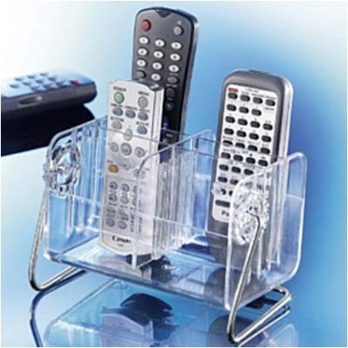
Current state
To control a lot of different equipments, Eg: two remotes for controlling the tv, but 1 is specifically used for tv switchOnOff and other for the set-top box
Page 6

Slide 7
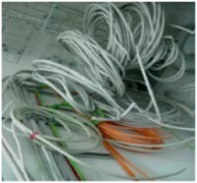
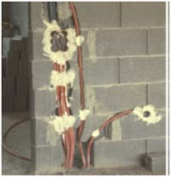
Cable: expensive & inflexible
Conventional wiring solutions
Time consuming
Material-intensive
Building Mess & Noise
Inflexible: This term is used, because this inserting wires in to the building walls need to be done before hand. And in case, you need to change the wiring then probably, you can still use the smallPathsInstalledForTheWires but the wiring system would need upgrade. Recall previous
Expensive Over Building Lifespan
High costs with retrofitting(add (a component or accessory) to something that did not have it when manufactured.) and change of use
Page 7

Slide 8
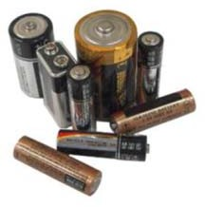
Conventional wireless technology requires batteries
Batteries require:
Monitoring & Tracking for the battery level
Stocking
Access and replacement
Costly Disposal for planet.
Batteries :
Cause Pollution
Require regular replacement
Page 8

Slide 9
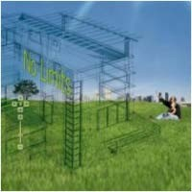

Customer wishes and modern house technology requirements
Easy use and install
Suitable for simple and complex applications
Simple function changes possible
Upgradeable, expandable and flexible at any time
Adaptable to technical innovations
Wide range of products and manufacturers
Good price/performance ratio
Page 9

Slide 10

The solution: EnOcean standard
Batteryless , wireless standard from EnOcean for intelligent buildings
High degree of flexibility
Comfort & security
Cost-saving
Reliable, future-proof technology
Energy efficiency
Low/No Maintenance
No wiring required for sensors
Involving no battery here in regards to sensors and actuators would mean that they would be capable
to generate their own energy
Page 10

Slide 11

EnOcean – your chance in the installer market
Shift to system business
Better distinction from the competition (unique characteristics)
Easy entry in EnOcean technology possible
Additional business (scalable offering - from small installations to automation)
Ready for law reforms, e.g. the EnEV 2014 in Germany
Page 11

Slide 12
Overview
Why wireless & batteryless?
EnOcean – the batteryless wireless technology
Installation
Radio: Basics & range planning
Support & next steps
Page 12

Slide 13

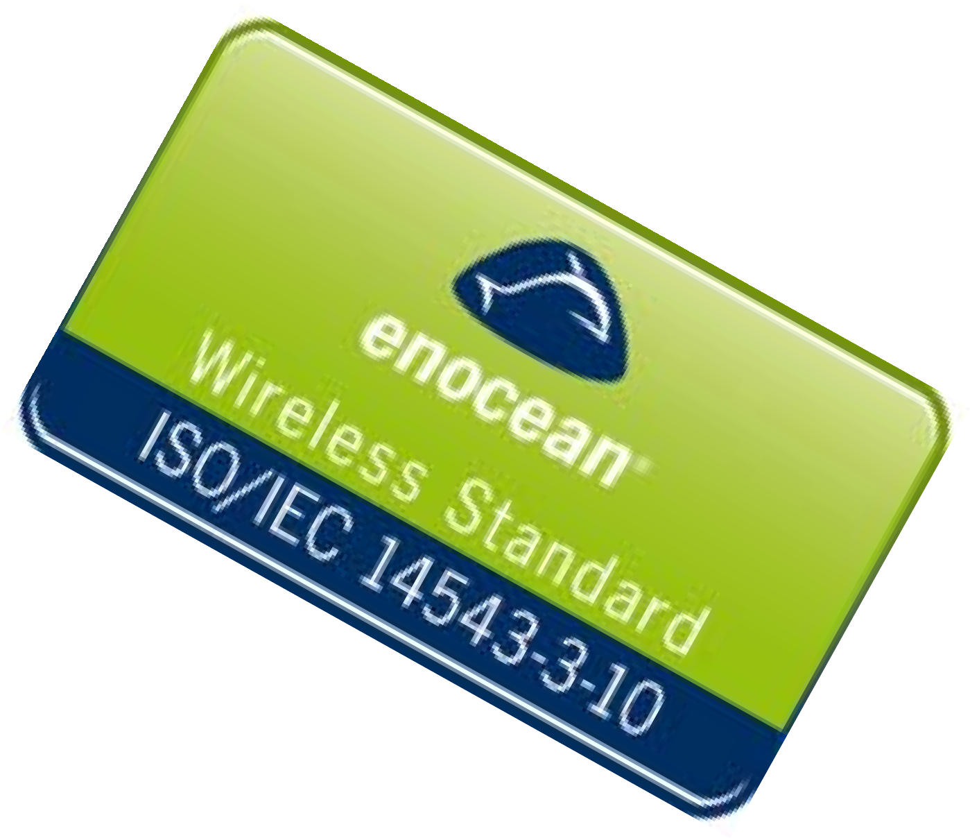


EnOcean – the radio standard for green buildings
No Wires
more than 1,200 interoperable products
International radio standard (ISO/IEC)
ISO/IEC JTC 1
No Batteries
Maintenance free
Environmentally friendly
No Limits
Maximum flexibility
More than 250,000 equipped buildings
Page 13

Slide 14
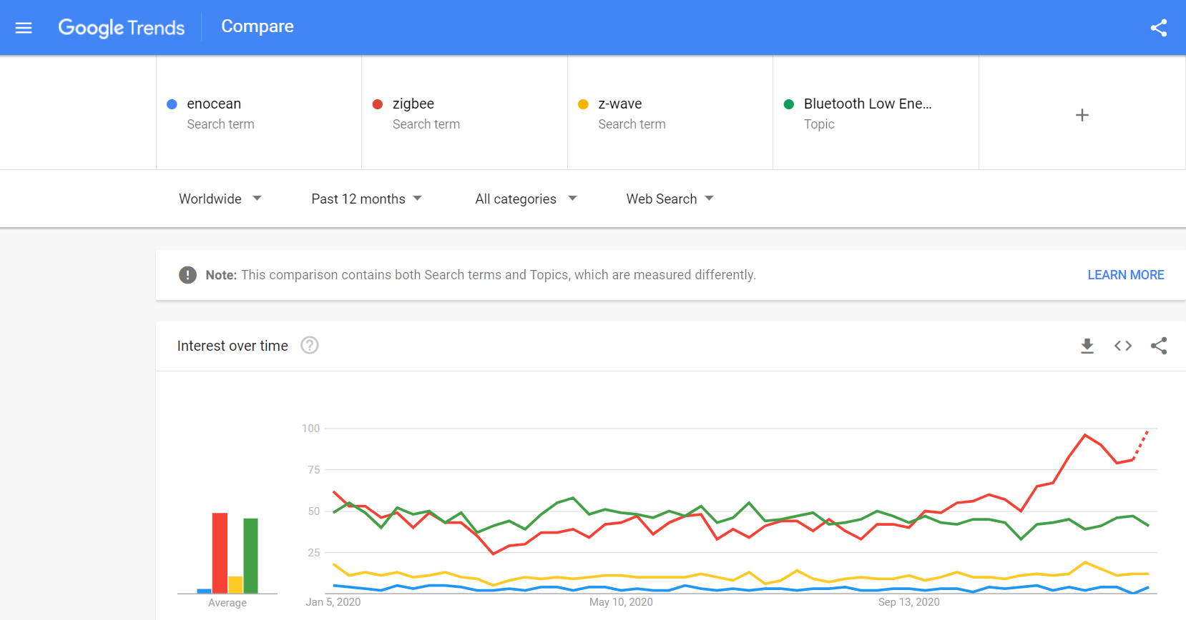
Enocean’s popularity is very low

Slide 15
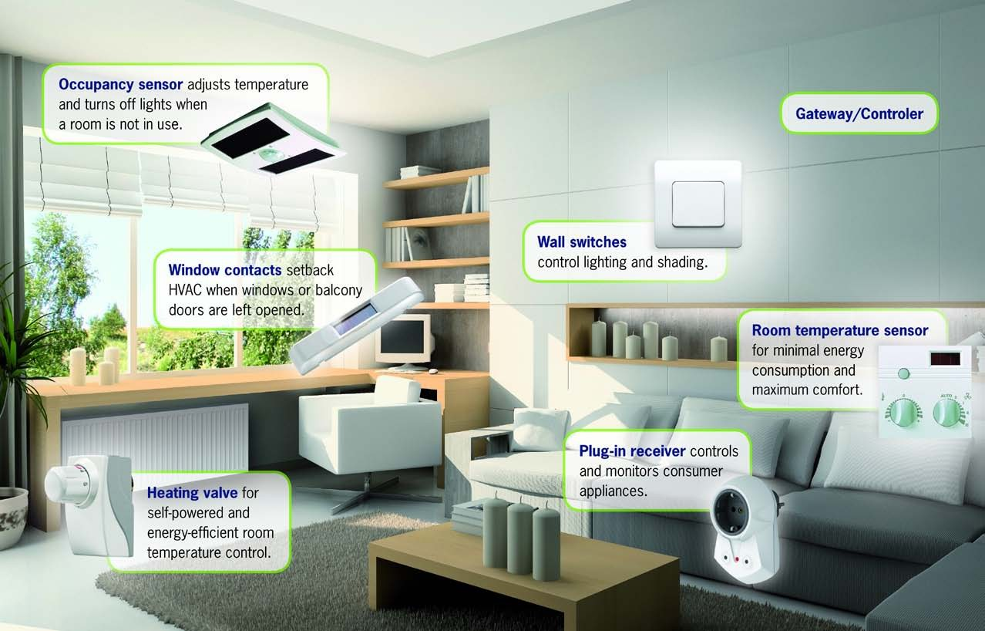

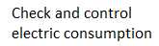
Batteryless wireless technology for residential markets/ smart homes
© EnOcean Alliance | Intelligent and Green Buidlings | 2014
Page 14

Slide 16
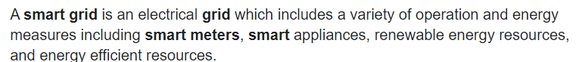
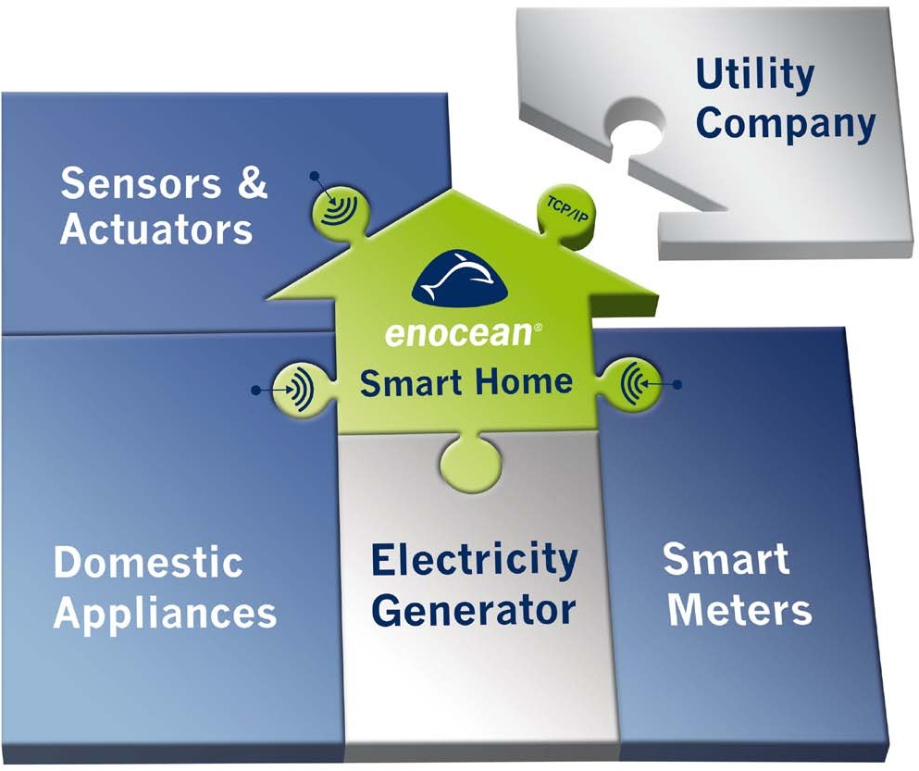
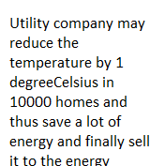


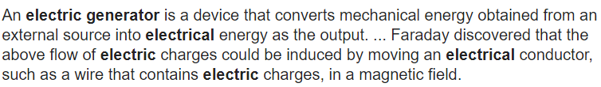
EnOcean – the basis for smart homes and building automation
© EnOcean Alliance | Intelligent and Green Buidlings | 2014
Page 15

Slide 17
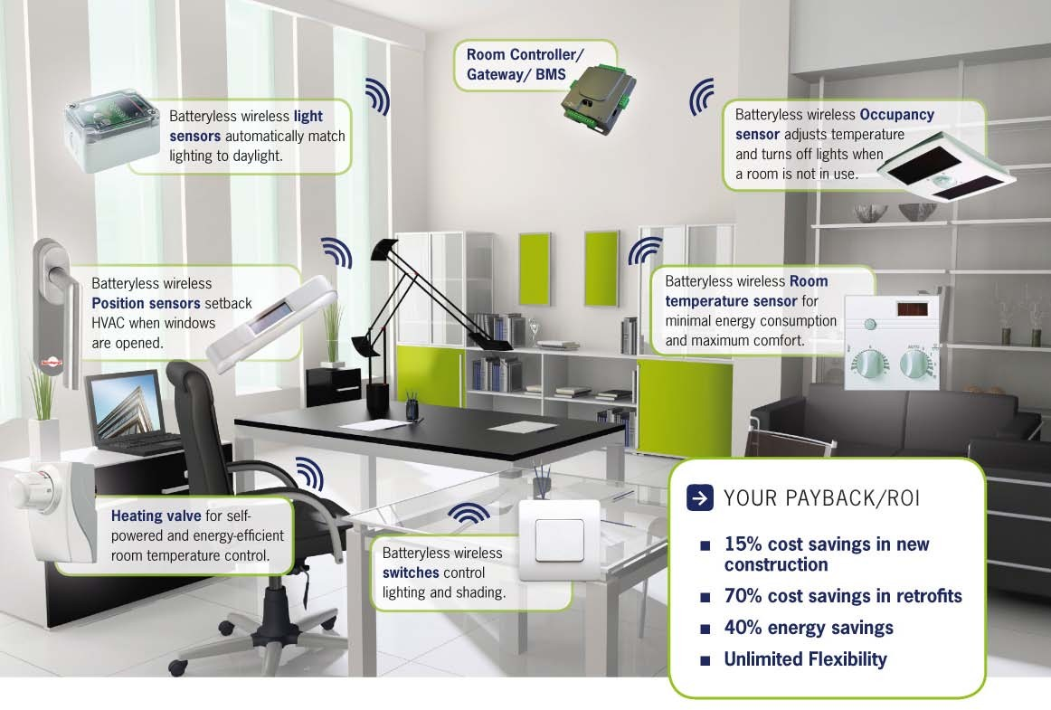


Batteryless wireless technology for building automation
16
16
© EnOcean Alliance | Intelligent and Green Buidlings | 2014 Page
© EnOcean Alliance | Intelligente Gebäude | Aug 2013

Slide 18
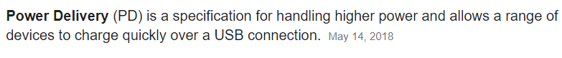
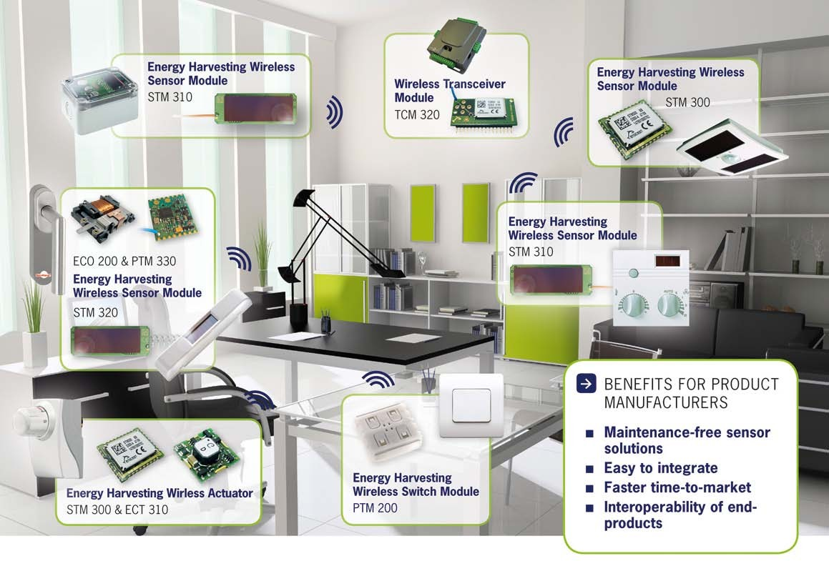
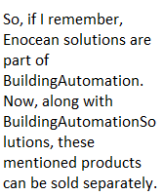
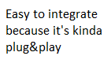
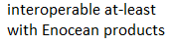
https://www.enocean.com/en/products/
Batteryless wireless technology from EnOcean
= energy harvester + radio modules

Slide 19
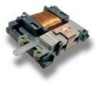

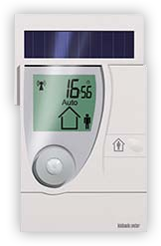
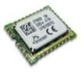
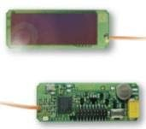

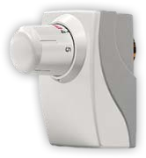
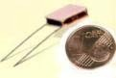
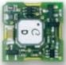
Energy Harvesting
Kinetic energy
Electrodynamic generator
Solar energy
Module with energy storage
Thermal energy
Energy generation through temperature differences

Slide 20

Basics of EnOcean radio
EnOcean radio
Energy generation through press of a button, light, differences in temperature
Wireless protocol: EnOcean ISO/IEC-Standard 14543-3-10
Frequency: license-free frequency band under 1 GHz (868 MHz in Europe and China, 902 MHz in North America, 928 MHz in Japan)
uni/bidirectional communication
Range
About 30m in buildings
Range extension with repeaters (Level 1 and Level 2)
Transmission security
short telegrams ~ 1ms
2 asynchronous repetitions
Encryption and Rolling Code (authentication)
Interoperability
each transmitter has an unique address (32Bit-ID)
standardized protocol and sensor profiles (EEP)
EnOcean Equipment Profiles (EEP's)

Slide 21


EnOcean is more environmentally friendly – than any other wireless devices
The "watt per square meter" is the SI unit for radiative and other energy fluxes in geophysics. The "solar constant", the solar irradiance at the mean earth-sun distance is approximately 1370 W m⁻².
COMPARISON OF HIGH FREQUENCY DEVICES
Device/ System W/m² Distance (m) Duration
EnOcean wireless switch 0,000013 1
few ms during actuation
100 x
Convent. light switch
0,0015
1
few ms during actuation
700 x
WiFi Access Point
0,01
2
during data exchange
7.000 x
Network card
0,1
0,5
during data exchange
70.000 x
DECT telephone
1
0,1
1,6 Mio.x av⁰e^{,1}rage
during phone call
Cell phone
12-42
during phone call
Cellular base station
0,00001 - 0,1
diverse permanence

Slide 22
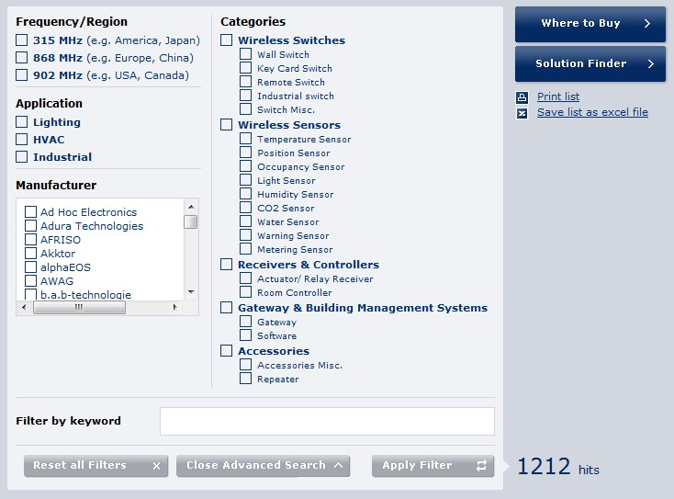
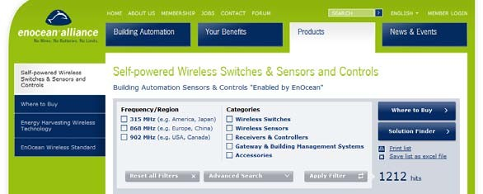
EnOcean-based products – www.enocean-alliance.org/products

Slide 23



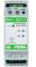
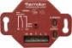




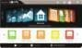
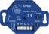
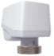



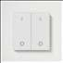
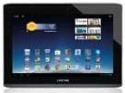

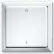
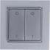

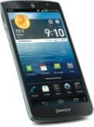
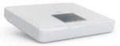
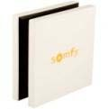
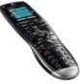
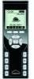

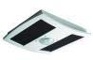
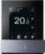
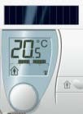
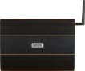

Multi-vendor interoperable solution for residential buildings/ smart homes
Switches and Sensors Actuators
LAN/WLAN
Merten Gira, Berker Jung
Easyfit
Central Units

Slide 24












Multi-vendor interoperable solutions for building automatoin
Switches and Sensors Actuators
LAN/WLAN
Merten Gira, Berker Jung
Easyfit
Building automation

Slide 25








Further applications with EnOcean
Pressure sensors for furniture and mattresses
Handheld transmitters for door operators
Mousetraps
Bus stop buttons
Industrial switches
Cable harness sensors
Avalanche protection sensors
….
24

Slide 26




References for residential buildings/ smart homes
EnOcean is worthwhile, from the first Switch-Receiver-Combination in:
Apartments
Detached and semi-detached homes
Prefabricated houses
Small commercial properties (e.g. practices, offices)

Slide 27
















Over 250.000 buildings worldwide –“enabled by EnOcean"
Offices
Hospitals
Industrial buildings
Residential buildings
Hotels
Historical buildings
Stores
Schools/ Universities

Slide 28


Activities of the EnOcean Alliance
Basis is the wireless standard for self- powered wireless applications
ISO/IEC Standard 14543-3-10
Application profiles EnOcean Equipment Profiles (EEP)
Secures interoperability of Endproducts
More than 350 members
Product manufacturers
System integrators
Specifiers, architects
Installers
Worldwide activities and networks

Slide 29

Benefits for installers and specifiers
Easy installation
Easy planning and highest flexibility through freely positionable sensors
Less noise and dirt
Upgradeable and extendable at any time
Wide range of interoperable products from various manufacturers
Reliable and future-proof technology

Slide 30
Overview
Why wireless & batteryless?
EnOcean – the batteryless wireless technology
Installation
Radio: Basics & range planning
Support & next steps

Slide 31













Easy installation:
1x Switch and 1x Receiver
Step 1:
Connect electrical loads with actuators (luminaires, shutters, sockets, heating valves).
■
Step 2:
Link switches and sensors once using the easy teach-in mode in the actuator.
One base installation = many functions

Slide 32
An actuator is a device that uses a form of power to convert a control signal into mechanical motion. From electric door locks in automobiles, to ailerons on aircraft, actuators are all around us.
Philips Hue is a line of color changing LED lamps and white bulbs which can be controlled wirelessly. The Phillips Hue line of bulbs was the first smart bulb of its kind on the market.

Slide 33





Easy installation: optional extension
Step 3 (optional)
Visualization with Touch-Panel
Connecting video cameras
Connection to the internet (Smart phone/PDA/Tablet)

Slide 34


Advantages for your clients
More comfort
Central functions
Scenes
Automation
Visualization/Touch-Panel
More security
Window monitoring
Panic button
Presence simulation
More energy efficiency
Heating control combined with window monitoring
Individual zone regulation/individual room control
…with user-friendy technology!

Slide 35


Advantages for the user: flexibility
Changes in the house – position switches in any location
In case of changes in furnishing
New furniture
New room layout
Conversion
Office room
Nursery
Nursing care
Simple retrofit
Handheld switch
Additional switches
Connection to exterior lighting
Pump in the garden pond

Slide 36




Freely positionable switches
Nursery – the switch is glued directly next to the bed – it’s safe as well as there is no direct electrical connection

Slide 37

Freely positionable switches – furniture
Bedroom – switch next to the bed

Slide 38


Freely positionable switches – glass
Bathroom – the switch can be next to the bath or shower

Slide 39



Remote control – scenes
Control blinds, dim lights, open doors
37

Slide 40



Remote control – garage door

Slide 41



More comfort with remote control
Control Lighting
Central on/off
Scenes
Control Blinds
Single/groups
Central on/off
Control Multimedia
Heating Control

Slide 42












Decentralized control – Blinds
Ideal for retrofits
No cables
Switches freely positionable
Functions
Individual control
Group control
Central control
Automation
Dimming
Light scenes
Components

Slide 43













Decentralized control – Lighting
Components
Switching actuators
Switches

Slide 44




Central control – easily expandable
Functions
Individual control
Group control
Central control
Automation
Dimming
Light scenes
Garden illumination
Garden pump

Slide 45





Individual heating control
Functions
Timer
Heating times programmable
Remote access possible
Components
Thermostats
Switching actuators for heating valves

Slide 46


Residential house in Schorndorf
Modern residential house
Problem
Running cables difficult – exposed concrete
Solution
EnOcean-based switches and thermostat
Advantages
Flexibility
Easy installation
Lower costs

Slide 47


Prefabricated houses with EnOcean technology
50% of all WeberHaus buildings are equipped with EnOcean technology
45

Slide 48


Commercial buildings: connection to b us systems
Switches and sensors Actuators
LAN/WLAN
Merten Gira, Berker Jung
Easyfit
Building automation
46
Page 46
© EnOcean Alliance | Intelligent and Green Buidlings | 2014
© EnOcean Alliance | Intelligente Gebäude | Aug 2013

Slide 49







Commercial buildings: axis-orientated installation with room controller
Building axis
Fassade
BUS supply Mains supply
Floor
Receiver
Fassade
1 Room controller for 8 building axis
Receiver, radius ca. 15m

Slide 50





















Functional buildings: flexible room structures with wireless technology
Building axis
Floor
Front
EnOcean Wireless Standard = Maximum Flexibility

Slide 51

Commerical buildings: advantages for the user
High energy efficiency due to optimal building automation
Simple planning - Easy adjustment if changes occur during the building phase
Highly flexible office areas
Lower running costs with changes in room structure or after a change in tenants
49

Slide 52

Commercial buildings:
Advantages for installers and planners
Easy planning and highest flexibility through freely positionable sensors
Less noise and dirt
Flexible room layout
Upgradeable and expandable at any time
Wide range of interoperable products and manufacturers
Compatibility with other building automation systems (e.g. EIB/KNX, LON, BACnet und TCP/IP)

Slide 53

Commercial buildings: The Squaire (AirRail Center)
The Squaire – Frankfurt, Germany
12.000 batteryless wireless modules from EnOcean

Slide 54










Over 250.000 buildings worldwide –
„enabled by EnOcean"
Offices
Hospitals
Industrial buildings
Residential buildings
Hotels
Historical buildings
Stores
Schools/ Universities

Slide 55
Overview
Why wireless & batteryless?
EnOcean – the batteryless wireless technology
Installation
Radio: Basics & planning
Support & next steps

Slide 56
Basics of radio signals
Range of wireless signals
Wireless signals are electromagnetic waves – the field strength at the receiver decreases as the distance to the emitter increases
In order to achieve maximum range, visual contact is not sufficient
A free zone (Fresnel zone) is required between transmitter and receiver; this zone is an ellipse
No interference from other wireless frequencies and radio applications such as Wi- Fi, garage doors, weather stations

Slide 57


Basics of radio signals in praxis
Typical range in practice
In a building with ideal conditions
30m, large open space
It’s best practice to plan max. 15m (planning security)
Possible losses due to furniture, persons, subsequent walls

Slide 58
Basics of radio signals
Radio transmission occurs as an ellipse
For maximum range,’ line of site ‘is not sufficient
Transmitter Tx
Receiver Rx
At a 30m range, the ellipse centre is theoretically around 10m. Narrow corridors with massive walls are therefore unfavorable.

Slide 59

Basics of radio signals – absorption
Absorption
Radio can penetrate walls – but signals are absorbed
Absorption rate depends on material
Examples
Wood, plaster, uncoated glass, no metal 0 – 10%
Bricks, press boards 5 – 35%
Concrete with iron reinforcement 10 – 90%
Metal, aluminium lining 90 – 100%

Slide 60


Basics of radio signals – penetration angle
Depending on the angle, the effective wall strength and absorption of the signal changes
Whenever possible, the signals should go vertically through the walls. Niches in walls are to be avoided
If flat penetration angles occur, repositioning of transmitter and/or receiver antennas or the use of a repeater is recommended

Slide 61



Basics of radio signals – antenna installation & sources of interference
Radio coverage along a wall area is to be avoided (e.g. also in a long corridor)
Whilst laying out a shielded antenna cable, take note not to bend the cable, to do so could damage it beyond repair
The distance from the EnOcean receiver to other high frequency transmitters should be a of min. 50 cm, the position isn’t critical. 868 MHz-RFID shouldn’t be used in the same room

Slide 62




Optimal positioning of solar-based sensors
Ambient light > 50 lux:
powers sensor and charges super capacitor
3 hours with 200 lux: enough energy for 14 hours in darkness
Fully charged devices can function
3 -5 days in darkness

Slide 63
Required amount of light in buildings
School
Blackboard
Typical schoolroom
500 – 1000 lx
300 – 500 lx
Office building
PC-work place
Conference room
Corridor
200 – 500 lx
300 – 700 lx
50 – 100 lx
Hotel
Reception
Restaurant
Staircase
300 – 700 lx
150 – 300 lx
50 – 150 lx

Slide 64



Range planning : tools
EPM 300 to check the possible range in buildings or outside
Level 1- and Level 2-repeater
System optimization possibilities: transmitters are received by 2 gateways
Information brochure „Range Planning Guide” to download:
http://www.enocean.com/fileadmin/redaktion/pdf/ app_notes/AN001_RANGE_PLANNING_2013_ en.pdf

Slide 65

Range planning for residential buildings
10m
Repeater not normally needed
Normal wall strength
10m
No aluminum / foil lining in walls
Transmitter or Receiver

Slide 66

Range planning for residential buildings
Repeater are recommended
At central point
Many actuators already have integrated repeater functions
Transmitter Or Receiver

Slide 67



Range planning in commercial buildings: Step 1
Take a Building Floor Plan and a Drawing Circle
Mark relevant Radio Shadings into the Floor Plan
Fire Protection Walls
Lavatories, Staircases, Elevator Shafts, Supply Areas….

Slide 68


Range planning in commercial buildings: Step 2
Draw in the receiving radii 10m–15m
10m-radii guarantee enough planning reserves Circle center = receiver position (+/- 1m is ok )
= 20m

Slide 69
Range planning in functional buildings: Connectivity to automation systems
Gateways can also be added to existing building automation systems.
Approach:
Which central building control system is used?
Which applications are desired?
Which products are to be used?
How many emitters per unit (axis, area, etc.) are desired?

Slide 70
Overview
Why wireless & batteryless?
EnOcean – the batteryless wireless technology
Installation
Radio: Basics & planning
Support & next steps

Slide 71

Start now with EnOcean!
Simple entry: retrofit with a decentralized solution
e.g. a switch and an actuator
Search for a fitting solution from over 1.200 interoperable products
More information and training can be found directly at the OEMs
http://www.enocean-alliance.org/en/wheretobuy/

Slide 72

Products –
http://www.enocean-alliance.org/en/products/
© EnOcean Alliance | Intelligent and Green Buidlings | 2014 Page 70

Slide 73

Find your solution –
http://www.enocean-alliance.org/en/solutionfinder/
71
Page 73

Slide 74

Available here –
http://www.enocean-alliance.org/en/wheretobuy/
Page 74

Slide 75

References –
http://www.enocean-alliance.org/en/references/
Page 75

Slide 76
Useful information
Coverage planning: http://www.enocean.com/fileadmin/redaktion/pdf/app_notes/AN001_RANGE_PL ANNING_2013_en.pdf
Brochures:
http://www.enocean-alliance.org/en/downloads/
Technical information:
http://www.enocean-alliance.org/en/white_papers/
Videos: www.youtube.com/user/EnOcean
Social Media
Twitter: http://twitter.com/enoceanalliance
Facebook: www.facebook.com/pages/EnOcean-Alliance/109269292485427
LinkedIn: http://www.linkedin.com/groups?mostPopular=&gid=3578554
Google+: https://plus.google.com/u/0/107585984916165196922
Page 76

Slide 77



EnOcean Alliance
2400 Camino Ramon, Suite 375 San Ramon, CA 94583
USA
Phone US: +1.925.275-6601
info@enocean-alliance.org www.enocean-alliance.org
Page 77

